Slide 1
VP160 Review Class 3
by Li Chunchao
2016/8/6

Slide 2
Short Review

Slide 3
Solving Problems

Slide 4
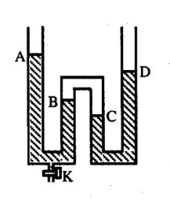

Liquid mechanics
After release some liquid by open the valve, the height of liquid change ΔA, ΔB, ΔC. Find the sign and the magnitude relationship between them.

Slide 5
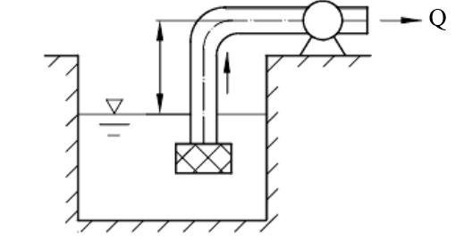
Liquid mechanics
There is a pumper. The distance between pumper and water level is h.
The rate of flow is Q (volume/time). Find the pressure inside the pumper. The atmospheric pressure is P0. The diameter of the pipe is d. The density of water is 𝜌.

Slide 6
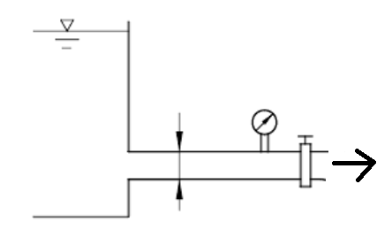
Liquid mechanics
Before releasing the valve, the reading of the pressure gauge is P1. After releasing the valve, the reading of the pressure gauge is P2. Find the velocity of the water in the pipe. The density of water is 𝜌.

Slide 7
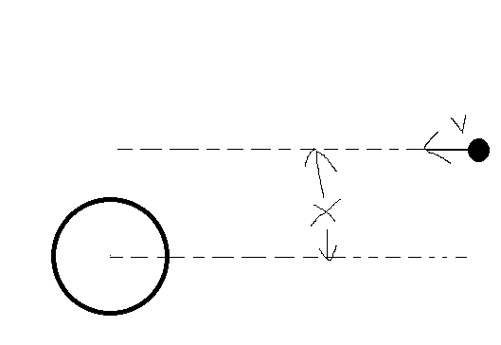
Gravitation
If there is a stone fly from very far place to the earth as the following picture. How fast should the stone fly at very far place if it will not fall on the earth. The Mass of earth is M. The radius of earth is R.

Slide 8
Q&A

